Slide 1

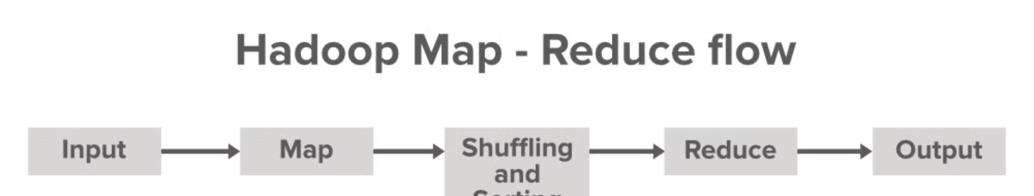

Introduction to Map Reduce
An overview of the Map Reduce concept, with rich details and examples of character count and word count.
Ma
by Meghana Anantam

Slide 2
Overview of the MapReduce concept
Sequential Processing
Key-Value Pairs
MapReduce processes each input in a sequential manner, enabling efficient data handling.
MapReduce works with key-value pairs, making it effective for a wide range of applications.
Fault Tolerance
Parallel Execution
Incorporates fault tolerance mechanisms to ensure the robustness of data processing.
It allows the distributed processing of data, enhancing the speed of computations.

Slide 3
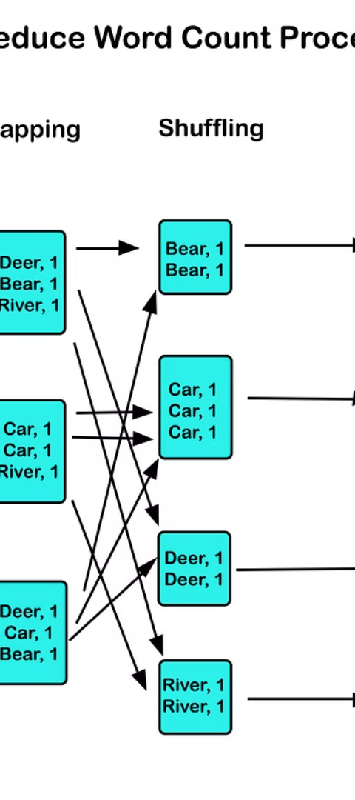
Example 1: Character Count
1
Input Data
Initialization of input data for the character count example.
2
Map Phase
Execution of the map phase to separate characters and assign frequency.
3
Reduce Phase
Aggregation of the mapped data to obtain the total count for each character.

Slide 4
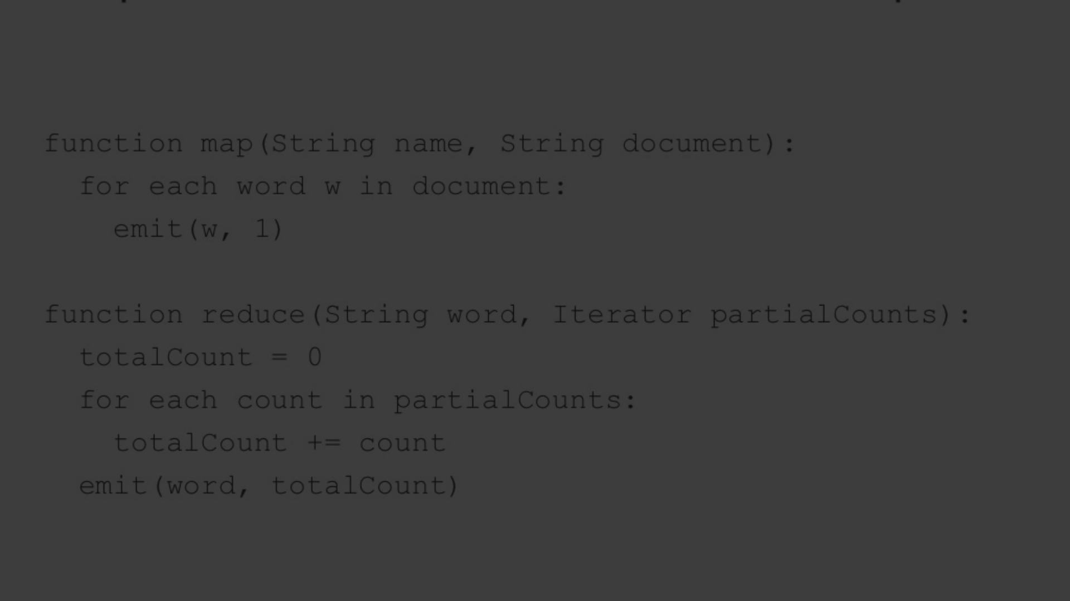
Explanation of the character count example
1
Character Separation
2
Frequency Aggregation
The map phase splits characters and assigns them to key-value pairs based on frequency.
The reduce phase aggregates and sums the frequency to obtain total character counts.

Slide 5
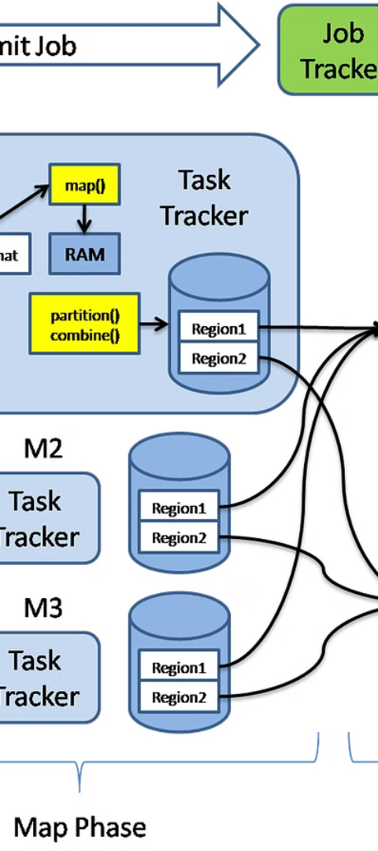



Step-by-step breakdown of the MapReduce process for character count
Input Data
Initialize input and split into key-value pairs.
Map Phase
Assign frequency and structure key-value pairs.
Reduce Phase
Aggregate and compute the final character counts.

Slide 6
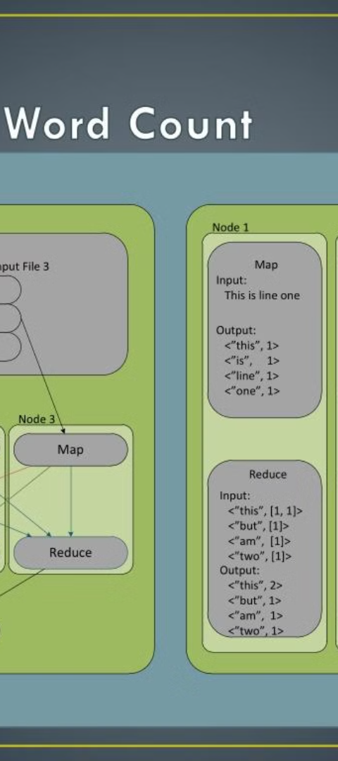
Example 2: Word Count
Splitting Words
Frequency Computation
The map phase separates words and assigns them to key-value pairs based on frequency.
The reduce phase aggregates and sums the frequency to obtain total word counts.

Slide 7
Explanation of the word count example
1
2
3
Initial Words
Mapping Process
Reducing Stage

Slide 8
Step-by-step breakdown of the MapReduce process for word count
Input Data
Map Phase
Reduce Phase
Splitting words
Assigning frequency
Aggregating frequencies

